Slide 1
Long Acting ART for Treatment and PrEP
Anton Pozniak MD FRCP
Consultant Physician

Slide 2
Disclosures
I have received honoraria, travel sponsorship and research grants from:
Gilead Sciences
Janssen
MSD
ViiV Healthcare

Slide 3
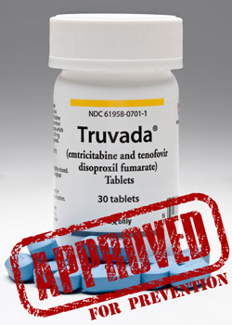
TDF/FTC was FDA Approved for use for Prevention on July 16, 2012
BUT… success depends on adherence.

Slide 4
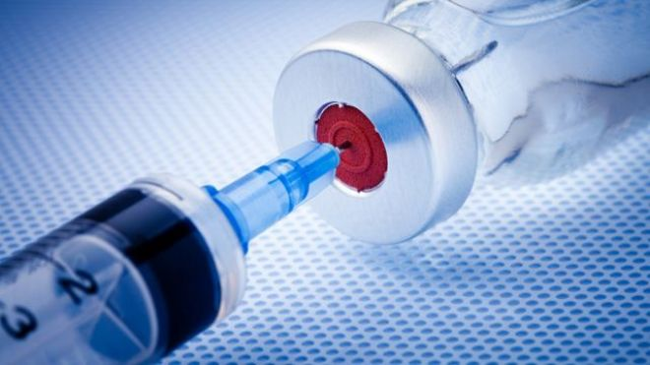
Long Acting – What’s the attraction?
Prevents poor adherence
Infrequent dosing
Use in patients with pill fatigue /aversion?
Better protects health privacy
Lower overall drug dose

Slide 5
Yearly intake of ARV by regimen
Regimen | Daily Dose (mg) | Yearly dose (g)
3-Drug Regimens: DRV/r + FTC/TDF RAL + F/TAF DTG/ABC/3TC EVG/c/FTC/TAF | 800/100 + 200/300 800 + 200/10 50/600/300 150/150/200/10 | 511.0 368.7 346.8 186.2
2-Drug Regimens: DTG + 3TC DTG + RPV CAB_{oral} + RPV_{oral} CAB_{im} + RPV_{im} | 50 + 300 50 + 25 30 + 25 400 + 600 (every 2 mo) | 127.8 27.4 20.1 6g
50 years of tx

Slide 6
Will there be demand for long-acting formulations?
Lessons from the contraceptive pill
Women choose multiple modalities:
Oral
Long acting injectable
Topical (Coil)
Implantable

Slide 7
LA formulations: Pros and Cons
PROS
– Allow =monthly dosing
– Tolerated well to date
– More convenient
– Less stigma
– May promote adherence
– Potential for DOT?
CONS
– Some require i.m. injection
– Long-term tolerability?
– Very long terminal ½-life
– Cannot be self-administered
– Potential for resistance in
non-adherent patients

Slide 8
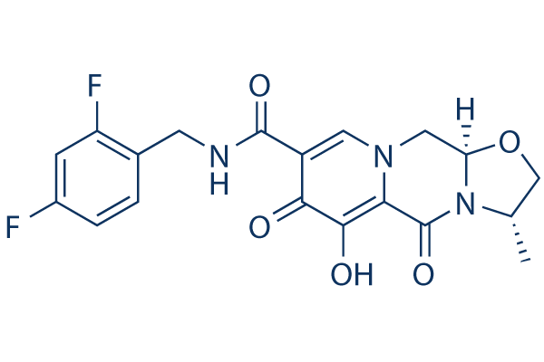
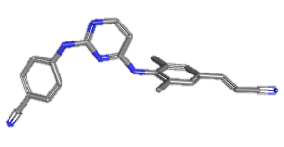
Most advanced Long – Acting Formulations
CABOTEGRAVIR
RILPIVIRINE LA
Terminal T½ 30-90 days (G001)
CYP3A4 substrate
Low DDI potential as victim or perpetrator
Animal studies support PreP
Loading dose increased to 900mg im
Treatment dose 600mg im q 4w
UGT1A1 (minor 1A9) metabolism
Low DDI potential as victim or perpetrator
Animal studies support PreP
Loading dose increased to 600mg im
Treatment dose 400mg im q 4w
Spreen HIV-HEPPK 16 and 17
Crawels HIV-HEPPK 16 and 17

Slide 9
LATTE-2: Cabotegravir IM + Rilpivirine IM for Long-Acting Maintenance ART
Multicenter, open-label, randomized phase IIb study
Cabotegravir: INSTI formulated as oral tablet and for long-acting IM injection
Induction Phase*
Maintenance Phase
Wk 16: RPV 25 mg PO QD added
Day 1
Wk 32
Wk 48
Wk 96
ART-naive HIV-infected pts > 18 yrs of age with CD4+ cell count > 200 cells/mm³ (N = 309)
Wk 20
CAB 400 mg + RPV 600 mg IM Q4W†
(n = 115)
CAB 30 mg + ABC/3TC 600/ 300 mg PO QD
CAB 600 mg + RPV 900 mg IM Q8W‡
(n = 115)
CAB 30 mg + ABC/3TC 600/300 mg PO QD
(n = 56)
*Pts with HIV-1 RNA < 50 copies/mL from Wks 16-20 continued to maintenance phase. †CAB loading dose at Day 1. ‡CAB loading doses at Day 1 and Wk 4.
Injections were 2-3 mL, IM (gluteal region), provider administered
Margolis DA, et al. Lancet. 2017;390:1499-1510.
Notes:
3TC, lamivudine; ABC, abacavir; ART, antiretroviral therapy; CAB, cabotegravir; IM, intramuscular; PO, orally; Q4W, every 4 weeks; Q8W, every 8 weeks; QD, once daily; RPV, rilpivirine.
In the phase IIb LATTE-2 trial, treatment-naive patients were treated with an induction period of oral therapy with investigational cabotegravir plus abacavir and lamivudine. After 16 weeks, oral rilpivirine was added, so for 4 weeks, they were taking 4 drugs. And at that point, once they were suppressed—and they had to be suppressed to enter the randomized portion of the study—they then either got injections of cabotegravir/rilpivirine every 4 weeks, injections of cabotegravir/rilpivirine every 8 weeks, or they continued their oral regimen.
This was a large phase IIb study, with 115 patients in each injection arm and 56 in the oral arm at a 2:2:1 randomization. The injections were 2-3 mL each IM in the gluteal region, administered by the provider. Patients had to come in for the injections.

Slide 10
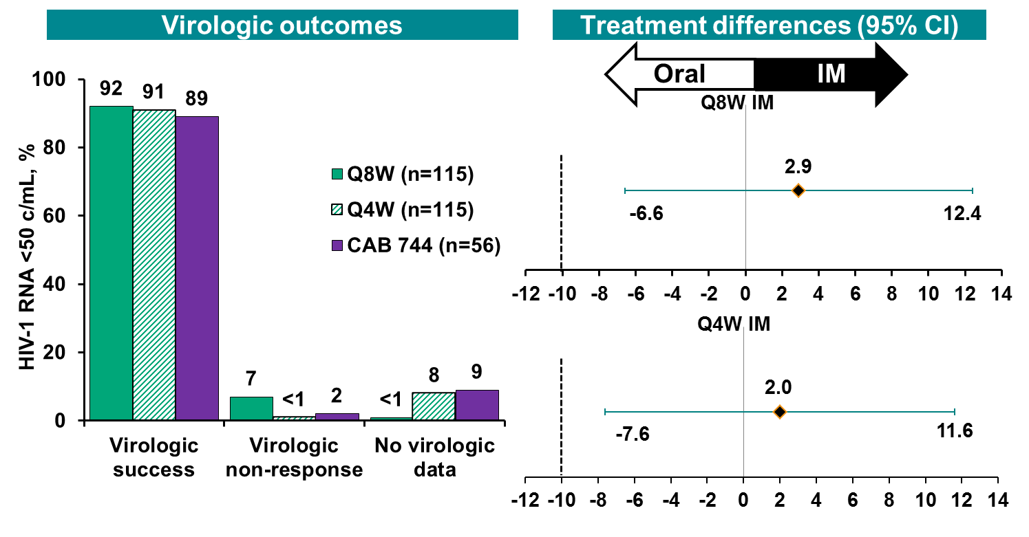
Switch to Long acting Injectables LATTE-2 HIV-1 RNA <50 c/mL at Week 48: ITT-ME (Snapshot)
Both Q8W and Q4W comparable to Oral CAB at Week 48ª
ªMet prespecified threshold for concluding IM regimen is comparable to oral regimen (Bayesian Posterior Probability >90% that true IM response rate is no worse than -10% compared to the oral regimen). Observed Bayesian Probabilities: Q8W vs Oral = 99.7%; Q4W vs Oral = 99.4%.
Margolis et al. AIDS 2016; Durban, South Africa. Abstract THAB0206LB.

Slide 11
LATTE-2 Week 48 Results: A/Es
99% of ISRs for pts receiving injectable therapy
grade 1 (82%) or 2 (17%); none grade 4
Most frequent ISRs: pain (67%), nodules (7%), swelling (6%)
2/230 pts (< 1%) withdrew for ISRs (both in Q8W arm)
AEs leading to withdrawal
Pooled Q4W/Q8W IM arms, 4%
PO arm, 2%
Margolis et al. AIDS 2016; Durban, South Africa. Abstract THAB0206LB.
Margolis et al, LB 91b, CROI 2014, Boffito M et al, Drugs 2014, Kumar L et al, Art Cells, Nanomedicine, and Biothechonology, 2014

Slide 12
Sustainable response LATTE-2: 96-Wk Results
Withdrawals between Wks 48 and 96:
CAB IM arms, n = 4 (n = 1 for AE, n = 3 withdrew consent)
CAB PO arm, n = 3 (all withdrew consent)
No additional PDVFs after Wk 48 in any arm
~ 88% of pts receiving IM CAB very satisfied to continue present treatment vs 43% receiving PO CAB
Phase III maintenance trials (ATLAS and FLAIR) assessing Q4W dose;
ATLAS-2M comparing Q4W and Q8W doses^{[2-4]}
Wk 96 Virologic Efficacy^{[1]}
IM CAB + RPV Q4W (n = 115)
IM CAB + RPV Q8W (n = 115) PO CAB + ABC/3TC (n = 56)
100
94
87
84
80
Treatment difference (vs CAB PO): CAB IM Q4W: 3.0% (95% CI: -8.4% to 14.4%)
CAB IM Q8W: 10.0% (95% CI: -0.6% to 20.5%)
60
Pts (%)
40
20
13
14
0
4
2
2
0
Virologic Success*
Virologic Nonresponse
No Virologic Data
*HIV-1 RNA < 50 copies/mL.
.
Notes:
3TC, lamivudine; ABC, abacavir; AE, adverse event; CAB, cabotegravir; ISR, injection-site reaction; PDVF, protocol-defined virologic failure; RPV, rilpivirine.
References
1. Margolis DA, et al. Lancet. 2017;390:1499-1510.
2. ClinicalTrials.gov. NCT02951052.
3. ClinicalTrials.gov. NCT02938520.
4. ClinicalTrials.gov. NCT03299049.
Key points:
Continued efficacy with injectable CAB + RPV; higher rate of virologic nonresponse with Q8W dosing but considerably higher rate of patients in Q4W dosing arm with no virologic data
No additional PDVFs after Wk 48 in any arm

Slide 13
LATTE-2: Resistance data
3 participants met protocol-defined criteria for virological failure
1 in oral dosing arm: no PR, RT or IN resistance mutations
2 in Q8W injection arm:
One with R269R/G mixture in IN (no fold-change)
One with K103N, E138G, K238T in RT and Q148R in IN (resistant to NNRTIs, RAL, EVG, CAB but DTG sens)
Margolis DA et al Lancet 2017

Slide 14
Long-Acting Cabotegravir for PrEP
CAB Trial | Design and Findings
ECLAIR^{[1]} Phase IIa (N = 127) | CAB LA IM (Q12W) vs PBO IM for men at low risk for HIV infection Encouraging results in terms of pt satisfaction and safety
HPTN 077^{[2]} Phase IIa (N = 199) | CAB LA IM (Q8W or Q12W) vs PBO IM for men and women at low risk for HIV infection Q8W dosing consistently met prespecified PK targets
HPTN 083/084^{[3,4]} Phase IIb/III (planned N = 4500/3200) | CAB LA IM (Q8W after 2 injections 4 wks apart) vs TDF/FTC PO QD for MSM/TGW (083) or women (084) at high risk for HIV infection; trial now recruiting (estimated completion: 2022)
Cabotegravir: INSTI formulated as oral tablet and for long-acting intramuscular injection
Considerations: may remove need for QD tablets; however, less control of drug intake and same potential for subinhibitory concentrations if doses missed
For all trials, an oral CAB phase preceded the injection phase.
1. Markowitz M, et al. Lancet HIV. 2017;4:e331-e340. 2. Landovitz R, et al. IAS 2017. Abstract TUAC0106LB. 3. ClinicalTrials.gov. NC
T02720094. 4. ClinicalTrials.gov. NCT03164564.
Notes:
CAB, cabotegravir; FTC, emtricitabine; LA, long acting; MSM, men who have sex with men; PBO, placebo; PK, pharmacokinetic; TDF, tenofovir disoproxil fumarate; TGW, transgender women.

Slide 15
HPTN 077 Study Design
Oral
Injection Phase
Follow-up
(800mg ever 12 weeks)
Phase
3:1
Oral
Injection Phase
Follow-up
(800mg ever 12 weeks)
Phase
HIV-uninfected men and women at low risk for acquiring HIV infection,
ages 18 to 65 (n=199)
Oral
Injection Phase
Follow-up
(600mg ever 8 weeks)
Phase
3:1
Oral
Injection Phase
Follow-up
(600mg ever 8 weeks)
Phase
Landovitz R, et al, 9th IAS, Paris, 2017. Abstract #TUAC0106LB

Slide 16
Grade 2 or Higher AE’s Experienced by >5% of Any Arm
n=177
(CAB 134, PBO 43)
AE > grade 2
90%
84%
Respiratory tract infection
25%
23%
Lipase increased
7%
9%
Injection site pain
34%
p < 0.0001
2%
Headache
15%
p = 0.03
2%
*Creatinine renal
clearance decreased
46%
44%
Blood glucose decreased
8%
5%
Blood creatinine increased
10%
7%
Blood creatine
phosphokinase increased
5%
12%
Back pain
7%
0%
0% 20% 40% 60%
* Grade 2: < 90 to 60 ml/min or 10 to < 30% decrease from participant’s baseline. Grade 3: < 60 to 30 ml/min or 30 to < 50% decrease from participant’s baseline.
80% 100%
Landovitz R, et al, 9th IAS, Paris, 2017. Abstract #TUAC0106LB

Slide 17
Other clinically significant events
Active Arm Discontinuations due to clinical AE, n=12
Gastrointestinal, n=1
Rash, n=3
Nervous system, n=8
Seizure, n=1
Seroconversion, Active CAB (Cohort 1)
Detected Study W77 (48W after final injection)
CAB levels BLOQ at W53 and 77
Wild type virus
Landovitz R, et al, 9th IAS, Paris, 2017. Abstract #TUAC0106LB

Slide 18
Percentage of Participants with ISR
Landovitz R, et al, 9th IAS, Paris, 2017. Abstract #TUAC0106LB

Slide 20
Emerging LA PrEP Strategies
Strategy | Examples
Long-acting ARVs | Cabotegravir LA IM injection Q12W well tolerated in phase IIa study (ÉCLAIR)^{[1]} MK-8591 (EFdA) has extended half-life in early-phase studies^{[2]}
HIV vaccines | HVTN100 vaccine met immunogenic criteria required to move into phase IIb efficacy studies^{[3]} Other vaccine concepts in earlier phases of study
Broadly neutralizing antibodies | VRC01, 3BNC117 bNAbs have extended half-lives in early studies,^{[4,5]} efficacy trials under way
1. Markowitz M, et al. Lancet HIV. 2017;[Epub ahead of print]. 2. Friedman EJ, et al. CROI 2016. Abstract 437LB. 3. Bekker LG, et al. IAC 2016. Abstract TUAX0102LB. 4. Caskey M, et al. Nature. 2015;522:487-491. 5. Lynch RM, et al. Sci Transl Med. 2015;7:319ra206.
Notes:
There are 3 very exciting emerging strategies that are in clinical trials. One is long-acting antiretrovirals. The first large prevention study in long-acting antiretroviral medication is looking at cabotegravir. It was found to be safe and well tolerated in the ÉCLAIR study. There's now parallel studies in the HIV Prevention Trials Network looking at this vs oral tenofovir/FTC for pre-exposure prophylaxis. It's actually looking at the drug given every 8 weeks. But it's efficacy studies, so we'll learn in the next year or two whether this is a useful approach.
There's another drug that's in earlier-phase studies, MK-8591, and there's some thought about developing this either as an implantable device or possibly can be given orally as infrequently as once a week. There's a lot of excitement about HIV vaccines. And one study in the HIV Vaccine Trials Network of a combination vaccine met criteria to move into a large efficacy trial that's under way in Africa. And other early vaccine concepts so the vaccine field still has a lot of excitement in it.
And then, instead of giving vaccines, actually taking broadly neutralizing antibodies—these are antibodies that people who are long-term nonprogressors produce and keep HIV in check. So maybe giving these in advance of exposure to HIV can be beneficial. So this may be part of the future.

Slide 21
Other LA drugs for treatment or PrEP

Slide 22
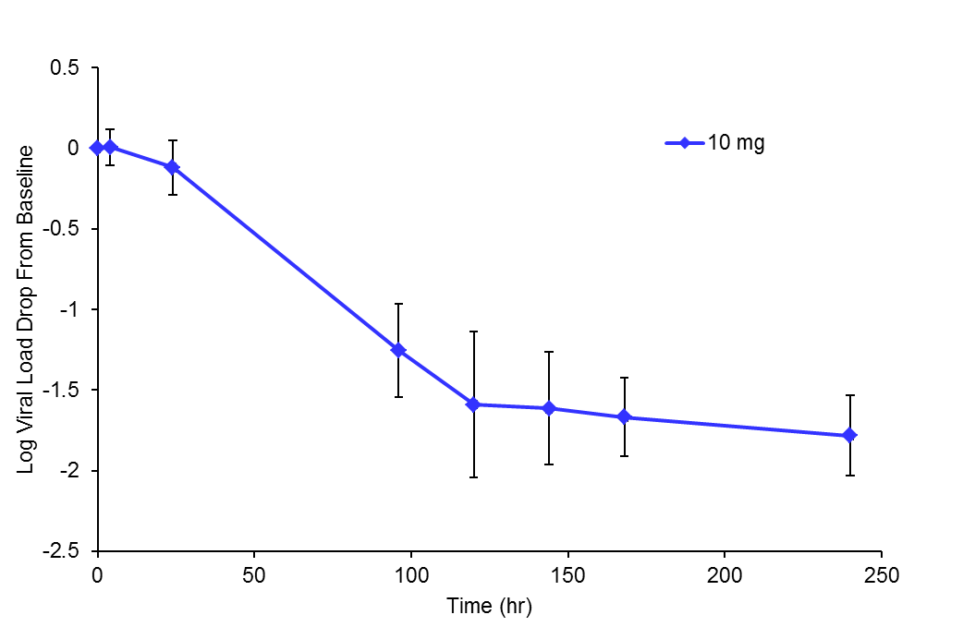
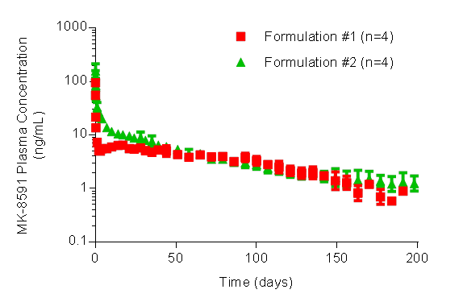
MK-8591 (EFdA) Nucleoside reverse transcriptase translocation inhibitor
Potential for a drug in an implant
MK-8591 is Effective in HIV patients when Dosed Once-Weekly: Results from ongoing Ph1b study
MK-8591 Parenteral Formulations Release Effective Drug Levels for >180 days
10 mg mean VL drop from baseline
-1.64
-1.78
A single 10 mg oral dose in HIV-infected patients results in 1.6 log decrease in viral load at day 7-10
Low dose amenable to extended-duration parenteral formulation
Llamoso C et al. HIV Glasgow 2016; Glasgow, UK. Oral # 335A/B.
Friedman, et al., CROI 2016 Poster# 437LB
Grobler et al CROI 2016
Notes:
Potent antiviral activity was demonstrated with MK-8591 administered QW in HIV positive patients, with a single 10 mg dose resulting in a 1.64 log VL reduction by day 7
Parenteral formulations exhibited >180-day extended release after a single injection in rats .Ongoing studies suggest the potential to provide coverage for durations up to 1 year

Slide 23
GS-CA1 -Capsid Inhibitor Mode of Action Summary
Target Cell
Producer Cell
Reverse Transcription
Capsid Core Disassembly
Nucleus
Gag
Gag-Pol
Maturation
Pre-integration complex
Nuclear Translocation
Integration
Nucleus
Capsid Core
Assembly
GS-CA1

Slide 24
GS-CA1 Pharmacokinetics in Rats Extended Release Formulation
Single subcutaneous injection maintains plasma concentrations well above paEC₉₅ for >10 wks
Potential for a monthly dosing interval or longer in humans
9x above paEC₉₅
Plasma Concentration, nM
paEC₉₅ = 11 nM
0
1
2
3
4
5
6
7
8
9
10
Weeks

Slide 25
Monoclonal Antibody against CCR5

Slide 26
mAb against CCR5 Pro140 monotherapy in ART suppressed patients
39 HIV-infected patients on suppressive ART
R5 virus by Monogram Trofile DNA assay
16 continued self-administration sc after week 13
15 eligible participants (median CD4 586 cells/mm3)
– 11 remained suppressed on PRO140 for >1 year
– 3 VF; one moved away from study site
– No change in co-receptor usage or susceptibility
No anti-PRO140 antibodies detected
Lalezari J et al CROI 2017

Slide 27
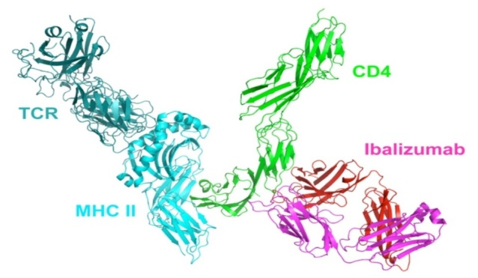
Ibalizumab – Long-Acting, Monoclonal Antibody
Active against HIV-1 resistant to all approved ARV agents
Binds to CD4 to prevent HIV attachment
Initial development as IV infusion to be administered every 2 weeks
In treatment-experienced patients (n=40) with resistance to approved ARV agents, After 24 weeks of treatment (with optimized background regimen):
Mean VL decrease of 1.6 log₁₀ from Baseline (55% with ≥1 log₁₀; 48% with ≥2 log₁₀)
43% of patients had VL of <50 copies; 50% with <200 copies
Adverse reactions were mild to moderate

Slide 28
TMB-301: Ibalizumab in Pretreated Pts Infected With Multidrug-Resistant HIV
Single-arm, open-label phase III trial^{[1]}
Primary endpoint: ≥ 0.5 log₁₀ HIV-1 RNA decrease at Day 14
Ibalizumab: humanized mAb to CD4 receptor that blocks postattachment HIV entry into CD4+ T-cells; FDA breakthrough and orphan drug designations
Control Period:
Day 0-7
Day 14 Primary Endpoint
Pts with HIV-1 RNA > 1000 copies/mL;
on ART ≥ 6 mos, on stable ART ≥ 8 wks; resistant to ≥ 1 ARV from 3 classes, sensitive to ≥ 1 ARV for OBR
(N = 40)
Wk 25
Ibalizumab
2000 mg IV Day 7
(Loading dose)
Continue Failing ART
Days 0-14
Ibalizumab
800 mg IV Day 21, Q2W
(Maintenance dose)
Switch to OBR
Day 14
53% with resistance to all drugs from ≥ 3 classes; 68% with INSTI resistance
TMB-311: pts who completed Wk 24 of TMB-301 could continue to receive ibalizumab for an additional 24 wks (N = 27)^{[2]}
1. Lewis S, et al. CROI 2017. Abstract 449LB. 2. Emu B, et al. IDWeek 2017. Abstract 1686.
Notes:
ART, antiretroviral therapy; ARV, antiretroviral; FDA, US Food and Drug Administration; OBR, optimized background regimen; Q2W, every 2 weeks.
Now we are going to get into the more novel drugs. Ibalizumab has been around for quite some time. It is a drug that inhibits viral entry following attachment to CD4 cells, and it is a monoclonal antibody to the CD4 receptor. It received orphan drug designation from the FDA.
This is the phase III study design. It involves the kind of patient that I mentioned at the very beginning: those rare individuals who are basically failing everything and have resistance in multiple drug classes. From Day 0 to 7, they got ibalizumab. And then at Day 14, their background regimen was allowed to change, and they could include all kinds of other agents, including other investigational drugs such as fostemsavir.

Slide 29
TMB-301/-311: Key Results
Virologic Outcome With Ibalizumab | TMB-301 |  | TMB-311
 | Day 14^{[1]} (N = 40) | Wk 24^{[2]} (N = 40) | Wk 48^{[3]} (N = 27)
≥ 0.5 log₁₀ HIV-1 RNA decrease, % | 83* | NR | NR
≥ 1.0 log₁₀ HIV-1 RNA decrease, % | 60 | 55 | NR
≥ 2.0 log₁₀ HIV-1 RNA decrease, % | NR | 48 | NR
Mean log₁₀ HIV-1 RNA decrease | 1.1 | 1.6 | NR
HIV-1 RNA < 50 copies/mL, % | NR | 43 | 59
HIV-1 RNA < 200 copies/mL, % | NR | 50 | 63
*P < .0001 vs 3% at end of control period.
Wk 24: 9 pts reported 17 serious AEs; 1 drug-related serious AE (IRIS) resulted in d/c
Wk 48 TEAEs (all mild/moderate): upper respiratory tract infection, 15%; diarrhea, 11%; rashes, 7%
1. Lalezari J, et al. IDWeek 2016. Abstract LB-6. 2. Lewis S, et al. CROI 2017. Abstract 449LB.
3. Emu B, et al. IDWeek 2017. Abstract 1686.
Notes:
AE, adverse event; IRIS, immune reconstitution inflammatory syndrome.
The results are shown here. You see that 83% of patients had at least a 0.5-log decrease by Day 14, and 60% had at least a 1.0-log decrease at Day 14. Now these are not the extreme decreases like we see with integrase inhibitors, but these results indicate at least that ibalizumab is an active antiviral. Of course, we always look to the proportion suppressed. You see that at Week 24, 43% were suppressed to less than 50 copies/mL, with 50% to less than 200 copies/mL. This compares well to what we saw with the VIKING studies of dolutegravir in a similar patient population. Now, ibalizumab is an infusion, so it is a little inconvenient. But this drug could potentially be lifesaving. Because it has orphan drug status, it may well be approved for use sometime in the next couple years.
Additional notes:
~60% with HIV-1 RNA < 50 copies/mL at Wk 48

Slide 30
Broadly Neutralizing Antibodies (bNAbs) for HIV Prevention
VRC01: monoclonal antibody directed against the HIV-1 CD4 binding site^{[1]}
Terminal half-life in PK study: ~ 15 days; demonstrated antiviral activity in HIV-infected pts
Randomized phase II prevention trials now under way
Low-dose/high-dose IV VRC01 or placebo Q8W for adults at high risk for HIV infection
MSM/TGW (North/South America) and women (sub-Saharan Africa); planned overall enrollment: N = 4200
Other bNAbs in development: 3BNC117, 10-1074[
Notes:
bNAbs, broadly neutralizing antibodies; MSM, men who have sex with men; PK, pharmacokinetic; TGW, transgender women.
References
1. Ledgerwood JE, et al. Clin Exp Immunol. 2015;182:289-301.
2. Lynch RM, et al. Sci Transl Med. 2015;7:319ra206.
3. ClinicalTrials.gov. NCT02716675.
4. ClinicalTrials.gov. NCT02568215.
5. Caskey M, et al. Nature. 2015;522:487-491.
6. ClinicalTrials.gov. NCT02824536

Slide 31
Dapivirine Vaginal Ring for HIV Prevention
HIV Protection Efficacy vs Placebo, % | ASPIRE/MTN-020^{[1]} (N = 2629) | IPM 027/Ring^{[2]} (N = 1959)
Overall | 27 (95% CI: 1-46; P = .05) | 30.7 (95% CI: 0.90-51.5; P = .04)
Age > 21 yrs | 56 (95% CI: 31-71; P < .001) | 37.5 (95% CI: 3.49-59.5)
Dapivirine ring: silicone elastomer vaginal matrix ring containing NNRTI dapivirine
ASPIRE/MTN-020 and IPM 027/Ring: multicenter, randomized, double-blind phase III trials of dapivirine ring PrEP vs placebo for HIV-negative women in sub-Saharan Africa
Adherence was lowest in women aged 21 yrs or younger
HOPE (ASPIRE) and DREAM (IPM 027/Ring) programs implementing open-label extension dapivirine ring studies
1. Baeten JM, et al. N Engl J Med. 2016;375:2121-2132. 2. Nel A, et al. N Engl J Med. 2016;375:2133-2143.
Notes:
PrEP, pre-exposure prophylaxis; SSA, sub-Saharan Africa.

Slide 32
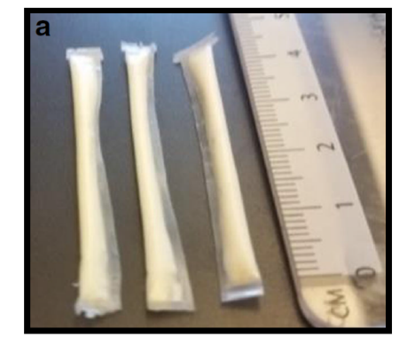
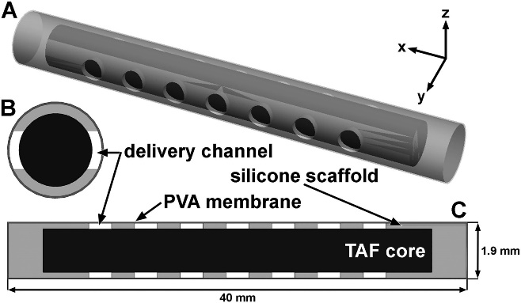
Long Acting Implants
Potential advantages over injectables
Removable
More consistent drug release
Could remain in place for years.
Potential disadvantages over injectables.
Specialised device required for insertion
Removal?
Regulated as both a drug and device.
Generic marketplace?
Schlesinger E et al Pharm Res 2016; 33: 1649-1656;
Gunawardana M et al; AAC; 2015; 59: 3913-3919

Slide 33
Long Acting – Oral
Nature Comms 2018; Jan 9th

Slide 34
Key Questions With Long-Acting ART
Can we move away from daily oral therapy for HIV?
Are emerging long-acting therapies as effective as oral therapies?
What about toxicity?
Is self-administration feasible? Is it desirable?
What pts might be ideal candidates for long-acting therapy?
How can resistance be prevented if pts miss doses?
Can these agents be used as PrEP?
Notes:
ART, antiretroviral therapy; PrEP, pre-exposure prophylaxis.
The key questions are: Can we move away from daily oral therapy? Will long-acting ART be as effective as oral therapies, which I have already noted are incredibly effective? What about toxicity? As a pharmacist said to me, with these long-acting drugs, once you give it, it is not easy to get it back! What about self-administration—is it feasible, and is it even desirable, or do we want to have control over this? Who are the ideal candidates? How can you prevent resistance if patients have missed doses? We are all afraid of that long tail where the patient has subinhibitory concentrations of the agent and, therefore, develops resistance. We already have examples of that with rilpivirine. And then there is the issue with prevention through PrEP.

